Slide 1

topic
International awards
Submitted to:- shashwat singhal
Submitted by:- unnati Chaurasia

Slide 2
INTRODUCTION
International awards are prestigious honors given to individuals or organizations for outstanding achievements at the global level. They recognize excellence in fields such as science, literature, sports, music, cinema, and social service. These awards encourage innovation, creativity, and hard work while inspiring others to achieve success. Winning an international award brings worldwide recognition, respect, and opportunities for growth.

Slide 3


SCIENCE AWARDS
Nobel Prize in Physics – Awarded for outstanding discoveries and contributions in physics.
Nobel Prize in Chemistry – Honors exceptional achievements in chemical sciences.
Nobel Prize in Physiology or Medicine – Recognizes major contributions to medical and health sciences.
Breakthrough Prize – Awards groundbreaking achievements in life sciences, physics, and mathematics.
Fields Medal – Honors outstanding mathematicians for exceptional contributions to mathematics.
Abel Prize – Recognizes significant achievements in the field of mathematics.
Turing Award – Considered the Nobel Prize of computing, awarded for major contributions to computer science.
Lasker Award – Honors important advances in medical research and public health.

Slide 4

SPORTS AWARDS
Ballon d’Or
The Best FIFA Football Awards
Laureus World Sports Awards
Olympic Gold Medal
FIFA World Cup Golden Ball
Golden Boot Award
ICC Cricketer of the Year Award
World Athlete of the Year Award

Slide 5
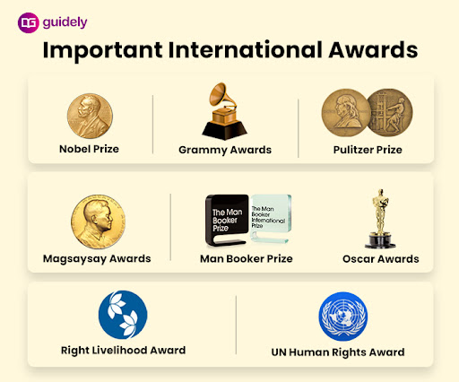
LITERATURE AWARDS
Nobel Prize in Literature
Booker Prize
Pulitzer Prize for Fiction
International Booker Prize
Hans Christian Andersen Award
Neustadt International Prize for Literature
Commonwealth Writers' Prize
Astrid Lindgren Memorial Award

Slide 6


CINEMA AWARDS
Academy Awards (Oscars)
Golden Globe Awards
BAFTA Awards
Cannes Film Festival Awards
Palme d'Or
International Emmy Awards
Venice Film Festival Golden Lion
Berlin International Film Festival Golden Bear

Slide 7
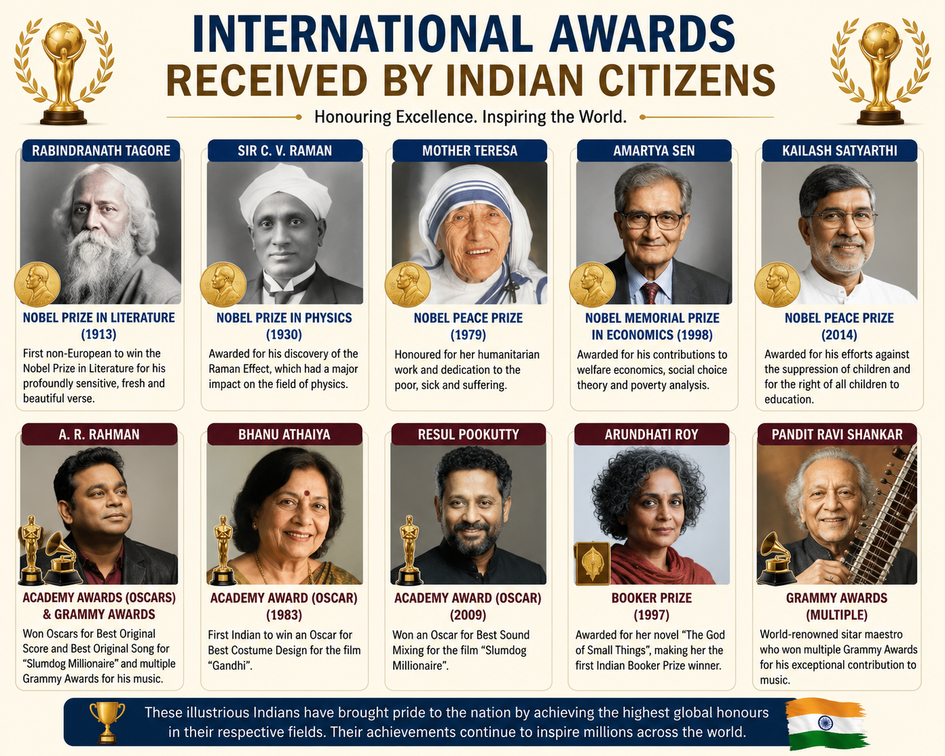
INTERNATIONAL AWARDS RECEIVED BY
INDIAN CITIZENS
Nobel Prize
Ramon Magsaysay Award
Booker Prize
Oscar (Academy Award)
Grammy Award
Laureus World Sports Award
UNESCO Awards
International Gandhi Peace Prize and Global Peace Awards

Slide 8
NAMES OF INDIAN PERSONS WHO
RECEIVED INTERNATIONAL AWARDS
S.No. | Name | International Award
1. | Rabindranath Tagore | Nobel Prize in Literature (1913)
2. | Sir C. V. Raman | Nobel Prize in Physics (1930)
3. | Mother Teresa | Nobel Peace Prize (1979)
4. | Amartya Sen | Nobel Memorial Prize in Economics (1998)
5. | Kailash Satyarthi | Nobel Peace Prize (2014)
6. | A. R. Rahman | Academy Awards (Oscars) and Grammy Awards
7. | Bhanu Athaiya | Academy Award (Oscar) for Costume Design
8. | Resul Pookutty | Academy Award (Oscar) for Sound Mixing
9. | Arundhati Roy | Booker Prize (1997)
10. | Pandit Ravi Shankar | Multiple Grammy Awards for Music

Slide 9

BENEFITS OF WINNING
INTERNATIONAL AWARDS
Global Recognition
Enhanced Reputation
Career Growth
Motivation and Confidence
Networking Opportunities
Financial Benefits
Inspiration to Others

Slide 10

CONCLUSION
International awards recognize outstanding achievements and contributions across various fields such as science, literature, sports, cinema, music, and social service. They honor individuals and organizations whose work has made a positive impact on society and inspired people worldwide. These awards encourage excellence, innovation, creativity, and dedication while promoting global cooperation and progress. Winning an international award is not only a symbol of prestige and success but also a source of motivation for future generations to strive for excellence and contribute to a better world.

